Slide 1
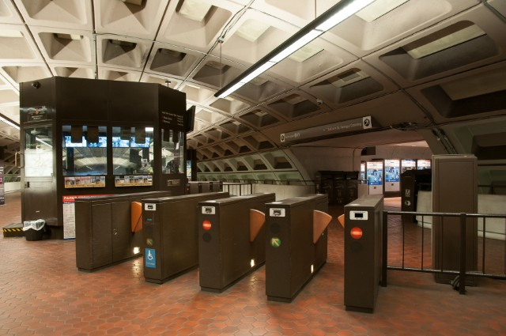
Washington Metropolitan Area Transit Authority
FQ18152
Metrorail Faregate Acquisition
Pre-Proposal Meeting
April 3, 2018

Slide 2
PURPOSE
The purpose of this meeting is to provide potential Offerors with an overview of the solicitation and solution requirements and to provide an interactive environment for questions and clarifications about the RFP.
Disclaimer: The Pre-Proposal Conference is for information purposes only. Statements or representations made during the Conference are not legally binding. Questions should be submitted in writing for an official WMATA response. Changes resulting from this Conference or the site visits are official only if issued through an Amendment to the RFP.

Slide 3
AGENDA
Safety Contact
Introductions
Objectives
Solicitation Structure
DBE and Insurance Requirements
Period of Performance, Liquidated Damages and Incentives
Proposal Requirements
Cost Sheet Review
Selection Criteria
Break
Design Features
Program Requirements
Existing Conditions
Deployment Requirements Overview
Questions
Site Survey

Slide 4
OBJECTIVES
Modernize faregates
Improve the customer experience
Increase faregate reliability
Reduce opportunity for fare evasion
Improve operational interfaces
Increase list service capabilities
Reduce power consumption
Introduce a pleasing design aesthetic that is complimentary to WMATA’s Metrorail historic appearance
Maintain current fare payment application and fare media while deploying hardware that is forward looking

Slide 5
SOLICITATION OVERVIEW
Solicitation Instructions
Proposal Requirements
DBE Goals
Price Sheet
Terms and Conditions
Insurance and Bond Requirements
Intellectual Property
Variation in Quantities
Representations and Certifications
Technical Specification and Statement of Work
Faregates
Station Terminals and Portable Devices
Faregate Maintenance
Software Maintenance
Parts Repair and Replacement Warranty

Slide 6
SOLICITATION OVERVIEW
Options
Silver Line and Purple Line Equipment
Extended Software Maintenance
Faregate Maintenance
Extended Parts Repair and Replacement Warranty
Solicitation Attachments
Requirements Compliance Matrix
WMATA Construction Safety and Environmental Manual
WMATA Safety and Security Certification Plan
WMATA IT NCS Design and Wiring Standards
IT NCS Approved Materials List
WMATA Standard Specifications

Slide 7
VENDOR REGISTRATION, DBE & INSURANCE REQUIREMENTS
Vendor Registration
https://www.wmata.com/business/procurement/index.cfm
DBE
DBE Goal 3%
Monthly DBE Compliance Reporting
Prompt Payment Certification
Davis and Bacon Wage Payroll Certification
Insurance and Bonding
Railroad Protective Liability (Can be purchased from WMATA)
Commercial General Liability
Business Automobile Liability
Workers Compensation
General Bond

Slide 8
PERIOD OF PERFORMANCE AND LIQUIDATED DAMAGES
 | Period of Performance | Liquidated Damages
Mobilization | NTP + 45 days
Design Review | NTP + 130 days
Testing | Design Review End + 120 | $4500/additional test day
Deployment Planning | Design Review End + 60
Training | Deployment Start – 60 days
Deployment | Testing End (+ 30) + 300 days | $8000/day
Faregate Warranty | Deployment End + 90 days
Parts Warranty | System Acceptance + 365 days
Software Maintenance | System Acceptance + 1095 days

Slide 9
PROPOSAL REQUIREMENTS
General
Offerors may submit multiple proposals
Technical proposals may include multiple options for specific requirements, but if the selection of one option over another changes the costs than it must be submitted as a separate proposal.
Each additional proposal must include a description of the variances from the first proposal
Submissions must include all 3 volumes as follows:
Volume 1 Cost/Price (1 original, 1 copy and 1 USB)
Volume 2 Technical ( 1 original, 3 copies and 1 USB)
Volume 3 Contractual ( 1 original, 1 copy and 1 USB)
Each additional proposal must include a separate Technical and Cost proposal but a single Contractual submission can cover all submitted technical and cost proposals.

Slide 10
PROPOSAL REQUIREMENTS
Technical Proposals
Past Experience
Key Staff Resumes
Team Description and Project Organizational Chart
Equipment and System Descriptions and Narrative of Responsiveness to WMATA Objectives and Critical Requirements
Equipment Data Sheets
Enhanced Functionality Narrative
Deployment Approach
Project Schedule
Requirements Compliance Confirmation

Slide 11
BASES OF AWARD
Best-value RFP
Higher weight for technical over price
Technical proposals will be scored without consideration of price
Proposals must meet all critical evaluation criteria and meet minimum technical evaluation scores for consideration
Technical evaluation team comprised of WMATA key stakeholders from different departments

Slide 12
COST SHEET REVIEW CONTRACT BASE
Line Item | Description
Mobilization | Up front costs for onboarding staff, insurance and bonding costs, and early action project management deliverables
Design Review | CDR, PDR, and FDR design packages, supplemental design documentation and deployment planning documents.
Testing | First Article Testing, Environmental Testing, System Integration Testing, Pilot, and In Service Testing
Training | Station Manager Training, Faregate Maintenance, Bench Maintenance, and Other Users
Faregates and Deployment | Unit costs for faregates and unit costs for deployment of faregates and associated equipment
Station Terminals | Unit costs for fully configured Station Terminals
Portable Devices | Unit costs for fully configured Portable Devices
90 Day System Maintenance Warranty | Labor, materials, and parts for 90 days of system operation after the last faregate is installed
Spare Parts | Recommended spare parts to support 1 year of parts and component replacement
Software Maintenance | Three years of system software maintenance and a 2000 hour labor allowance for software programming and engineering enhancements
Parts Repair and Replacement | One year of parts repair and replacement from the end of the 90 day warranty period.

Slide 13
COST SHEET REVIEW CONTRACT OPTIONS
Line Item | Description
Silver Line and Purple Line Equipment | Unit costs for faregates, Station Terminals and Portable Devices for Silver Line and Purple Line stations and the unit costs for the deployment of faregates and associated equipment
Extended Software Maintenance | Two one year options to maintain system software and labor allowance for software programming and engineering enhancements
Faregate Maintenance | Three year option for faregate corrective and preventative maintenance and coordination of parts repair and two one year additional options.
Extended Parts Repair and Replacement Warranty | Four one year options for faregate parts repair and replacement.

Slide 14
CRITICAL REQUIREMENTS
Interface with WMATA’s current fare payment system, accepting WMATA fare media, processing all fare schedule rules, and processing all list service transactions.
Comply with all applicable federal and industry standards including ADA, NFPA 130, NFPA 70, PCI, and Title VI.
Provide secure data storage and communications that includes user and device authentication protocols.
Support local, central and portable faregate management.
Support emergency safety functionality including the automatic opening faregate barriers and activation of emergency lighting with the loss of power or with the triggering of WMATA’s emergency alarm system and the automatic retraction or opening of barriers when obstructed.
Process at least 35 ingress or egress transactions per minute and emergency egress of at least 50 customers per minute.

Slide 15
TECHNICAL EVALUATION
Evaluation Measure | Score Range | Minimum Score
Integration with current fare payment application | 0 - 25 | 18
Qualifications | 0 - 20 | 13
Adherence to Requirements | 0 - 20 | 13
Deployment Approach | 0 - 20 | 13
Design Aesthetic | 0 - 5 | 3
Power Saving | 0 - 5 | 3
Enhanced Functionality | 0 - 5 | 3
**Minimum qualifying score is 66 points

Slide 16
DESIGN FEATURES
Customer Interface
Larger customer display with variable messaging and adjustable brightness
Programmable audible tones
Improved directional signage and customer messaging
User Interface
Local and centralized faregate status monitoring and controls
Portable Station Manager devices that will allow faregate control outside the kiosk
Centralize faregate control, monitoring and status reporting including:
Centralized faregate management
Station Manager log-in and reports
Device event monitoring and reporting
Performance monitoring against metrics and dashboard reports

Slide 17
DESIGN FEATURES
Faregates
Bi-directional retractable or paddle barriers (saloon style)
Stainless Steel Grade 316L or better w/ No. 4 brush finish, and Metro brown accent coloring
Cycle time of 700 ms
Throughput of 35 customers per minute and at emergency egress of least 50 customers
Barrier gap not more than 2 inches
Adjustable sensor capability
Configurable audible and visual alarms
Configurable audible and visual payment confirmation indicators
Concession fare indicator lighting
List service memory of 2 million items each (“hot list” Smart Benefits, web sales, and refunds)
Option for alternative fare media (non-SmarTrip)
Customer display for balance, available fare media, list services transaction
Modular design, security locks, maintenance log-in
Designed to support a second Payment Processing Target

Slide 18
DESIGN FEATURES
Station Terminals
Faregate management (place in and out of revenue service, select directional configuration, and open on demand)
Support a configurable emergency alarm system delay
Panic button to open all faregates on-demand
Manage display lighting and alarm settings
Support Station Manager log-in and log-off and maintain log records
Include card reader and support customer fare media inquiries
Direct connectivity to faregates

Slide 19
DESIGN FEATURES
Portable Devices
Provide secure faregate management (place in and out of revenue service, select directional configuration, and open on demand)
Include card reader and support customer fare media inquiries
Connect to faregates via WMATA MetroNet WiFi
Include protective casing
Configured to allow for WMATA to install additional applications on the device

Slide 20
DESIGN FEATURES
Central System Functionality and Reporting
Remote faregate management (place in and out of revenue service, select directional configuration, and open on demand)
Remote faregate diagnostics
Configurable status monitoring (system wide or by mezzanine)
Dashboard status reporting (device status, faregate configurations, log information, entry/exit transactions, alarm events)
Routine reports (log information, events information, transaction data)
Push down software and firmware upgrades and maintain version control records
Connect to faregates and station terminals via WMATA MetroNet WAN

Slide 21
PROGRAM REQUIREMENTS
Program Management
Experienced Project Manager, Quality Manager, Technical Manager, Training Manager, Maintenance Manager
Use Procore for Document Management
Design Review (Pre-Design Meetings, CDR, PDR, FDR)
Testing (FAT, Environmental Testing, Systems Integration Testing, Pilot Testing, In-Service Testing)
Deployment (Installation at up to 3 mezzanines per night with not more than one aisle left out of service)
Maintenance through 90 days after deployment
Parts replacement for 1 year after system final acceptance
Software maintenance 5 years after system final acceptance
Optional device maintenance for 5 years

Slide 22
PROGRAM REQUIREMENTS
Safety
Safety Certification Plan
Site Specific Work Plan
Supplement Work Plan (for special circumstances)
Power and Wiring Diagram Deliverables
Installation Interface Plan
Deployment Plan
Pre-Installation Inspections
Compliance with WMATA Metrorail Safety Rules

Slide 23
PROGRAM REQUIREMENTS
Security
Secure communication protocols with device authentication
Faregate locks and maintenance user authentication
System wide user authentication for various user interfaces
Authenticate users with WMATA Central Director
Data Encryption
Security Plan

Slide 24
PROGRAM REQUIREMENTS
Quality
Quality Manager (does not report to PM)
Deployment Quality Manager (does not report to deployment PM)
Program Quality Management Plan
Deployment Project Specific Quality Management Plan (Based on FTA-IT-90-5001-02.1)
Risk Management Plan
System Performance Reporting and Metrics
In-Service Reliability Testing (First 90 days of deployment)

Slide 25
SITE CONDITIONS
Aging Infrastructure
Faregate power and comm are accessed from U/F duct raceway
A typical duct configuration has a 6 inch comm and power duct and 4 inch emergency power duct
Power and comm stub-ups that access faregate from the U/F duct are adapted to current faregate cabinets dimensions
Faregates power is accessed with twist lock receptacles that sit up to 3 inches above the floor
Faregate main power uses a single home run circuit and emergency power is daisy chained from a different power source
Some mezzanines don’t have elevator access

Slide 26
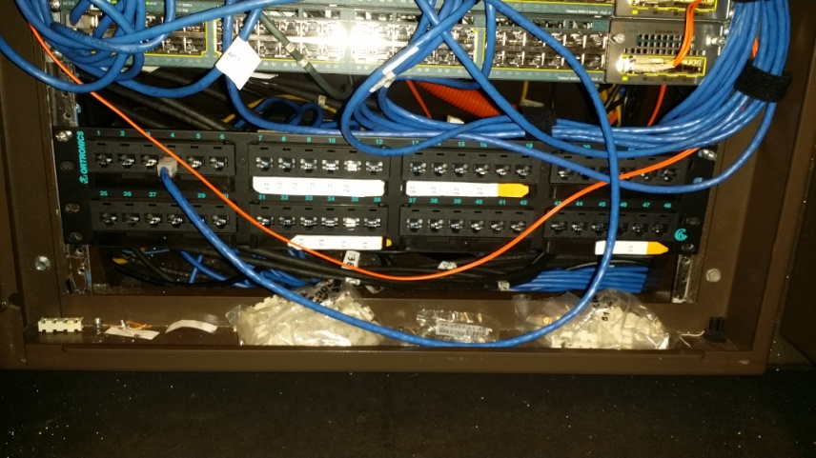
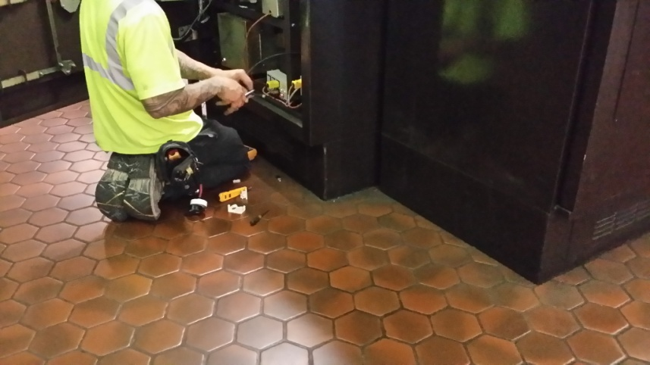
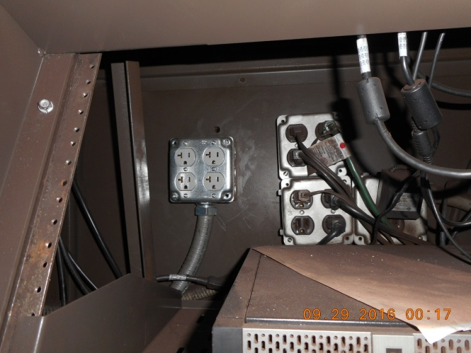
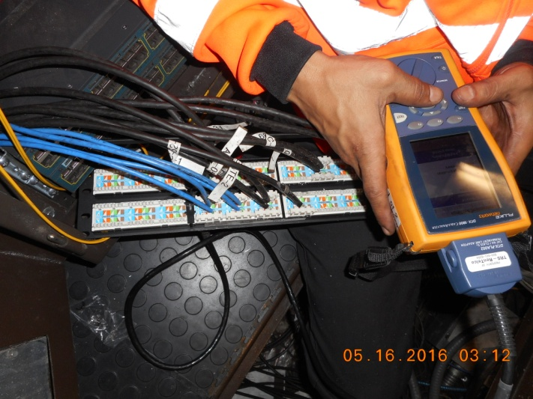
DEPLOYMENT PREPERATIONS
Finished up with tiling of handhole/junction box cover

Slide 27
TYPICAL FAREGATE RACEWAYS
7”
FREE SIDE
Typical Emergency
Power Duct
PAID SIDE
Typical
Power Duct
Typical
Comm Duct
Alt Comm Duct
3.125”
Center Line
6.25”
6.25”
3.125”
Covering with 3/4” fire-rated plywood base board
72”
Faregate Cabinet Width: 11”
ADA Faregate Cabinet Width 11”
Faregate Height 39.5”
Standard Aisle 21”
ADA Aisle 36”
* Aisle size may vary

Slide 28
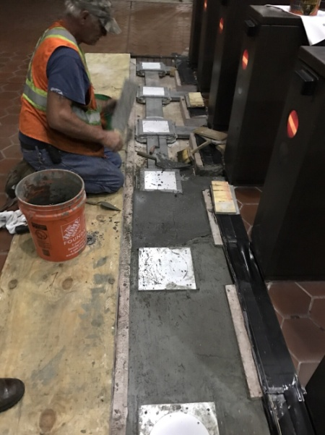
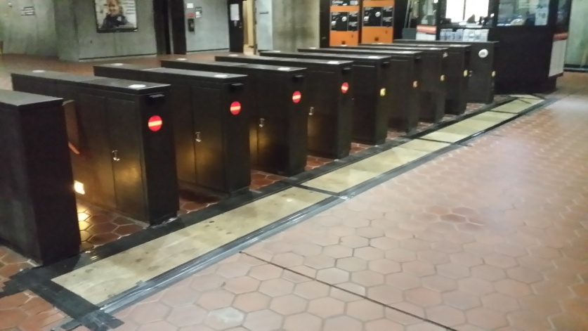
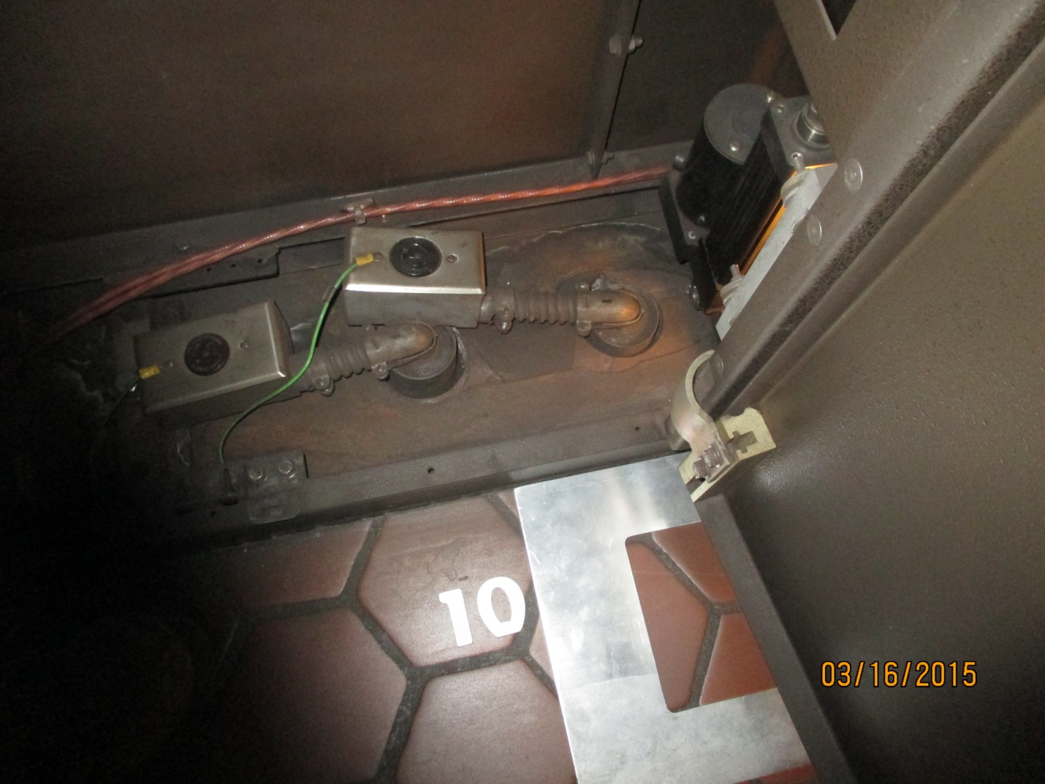
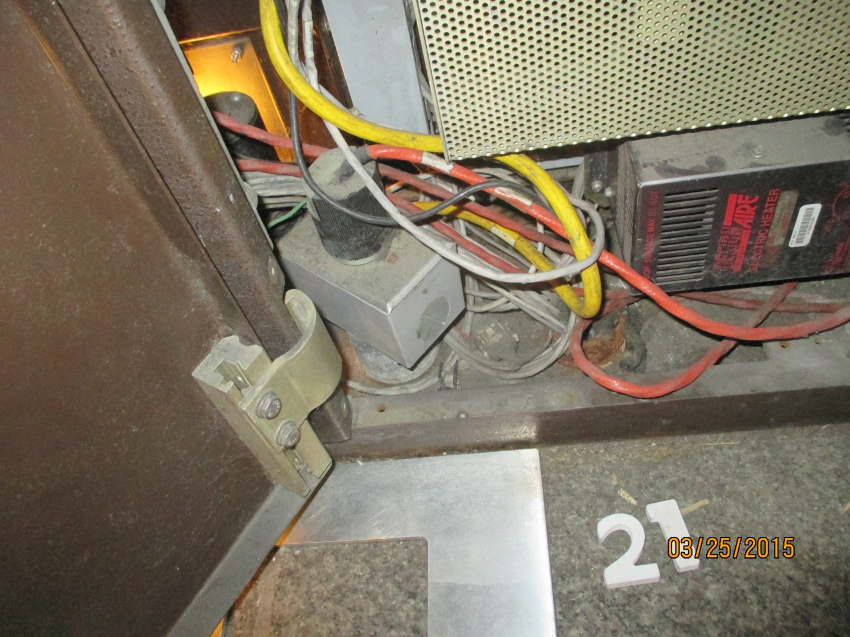
EXISTING CONDITIONS
Covering with 3/4” fire-rated plywood base board
Finished up with tiling of handhole/junction box cover

Slide 29
DEPLOYMENT DEMARCATION OF RESPONSIBILITY
WMATA Responsibility
Comm switch and connectivity to MetroNet backbone
Single CAT 6 Cable to kiosk terminated at patch panel and faregate cabinet
Power and communications raceway to faregate cabinet
Site access for up 3 mezzanines per from 11:00 pm to 5:00 am (tasks that impact egress may not begin until station closure)
Tile repair
Contractor Responsibility
Storage and delivery of faregates
Removal and temporary storage of existing faregates
Installation of faregates and supporting equipment including anchoring equipment, connecting to power, and connecting to emergency system
Modifications to faregate power, if needed, including: repositioning of electrical receptacles, replacement of electrical receptacles, pulling electrical wire from kiosk to faregate
Modifications to communication cables inside faregate
Restoration of worksite for revenue service

Slide 30
DEPLOYMENT CONSTRAINTS
Site access time restrictions (11:00 pm to 5:00 am)
Revenue service and egress requirements (work task at the faregate array in most instances may not begin until the last train leaves the station and active work must end at 4:00 am to ensure that faregates are operational)
MetroNet access coordination (require IT NCS escort to connect to MetroNet)
Faregates must be powered from twist lock receptacles and current and the size and placement of these receptacles inside the faregate cabinet is obtrusive and not consistently positioned.
Power outage coordination (WMATA requires a 4 week lead time to facilitate planned power outages)
Equipment delivery and removal (coordinated to avoid rush hour and event traffic)
Stations with no elevator access (coordination with ELES for special escalator lifts with weight restrictions)
Special security coordination (Pentagon and Arlington Cemetery stations require special coordination)

Slide 31
EQUIPMENT QUANTITIES
 |  | Total Aisles | ADA Aisles | Regular Aisles
Current System Replacement | System wide Replacement AFC Lab/Training | 895 11 | 138 3 | 757 8
Planned System Expansion | Shady Grove Union Station N Silver Line (2) Purple Line Potomac Yards | 4 3 37 16 8 | 1 1 7 3 2 | 3 2 30 14 6
Possible Added Capacity | Expanded Faregate arrays at up to 10 Mezzanines | 15 | 1 | 14

Slide 32
QUESTIONS
?

